Slide 1
Southwick Regional School
WELCOME TO
OUR ANNUAL
COLLEGE PREPARATION
PRESENTATION

Slide 2
SAT/ACT Preparation Ideas:
Take challenging courses in high school
Free on-line practice tests – collegeboard.org & act.org
Take review courses
Study Guides

Slide 3
Minimum College Requirements
4 English courses
3 Math courses (4 math - MA State only)
Algebra I, Geometry & Algebra II
3 Science courses (2 labs) (3 labs-MA State only)
Physics, Chemistry or Biology
2 Social Science courses
2 World Language courses (same language)
2 college preparatory electives

Slide 4
College Search Timeline
Spring – Junior Year
Determine search criteria
Research schools (ie. @ collegeboard.com/Naviance.com)
Take SAT/ACT (SAT II, if applicable)
Individual appointment with School Counselor
Late Spring/Summer
Visit/tour colleges
Gather information (ie. college fair)
Fall – Senior Year
Take SAT/ACT (SAT II, if applicable)
Tour/interview @ colleges
Secure recommendations
Finalize list of colleges – reach/fit/goal
APPLY!

Slide 5
College Applications
Complete application
Independent application
Common Application
College Essay/Letters of recommendation
Transcript request
Standardized test scores:
SAT I/SAT II (from College Board)
ACT (from ACT, Inc.)
Application fee ($25-$80)
Interview/Audition
Adhere to deadline dates

Slide 6
Career Exploration
Junior year job shadows
Volunteering
Aptitude test (ASVAB) & interest assessments
Career/college search websites
Interest area field trips & speakers
Naviance:
College & Career Readiness
Career Exploration

Slide 7
Diversified Learning Experience
A highly structured internship program
March - select DLE on course selection sheet (5-10 cr.)
Complete internship application
Appointment with Career Facilitator
Conference with mentor & parent/guardian to develop goals & competencies

Slide 8
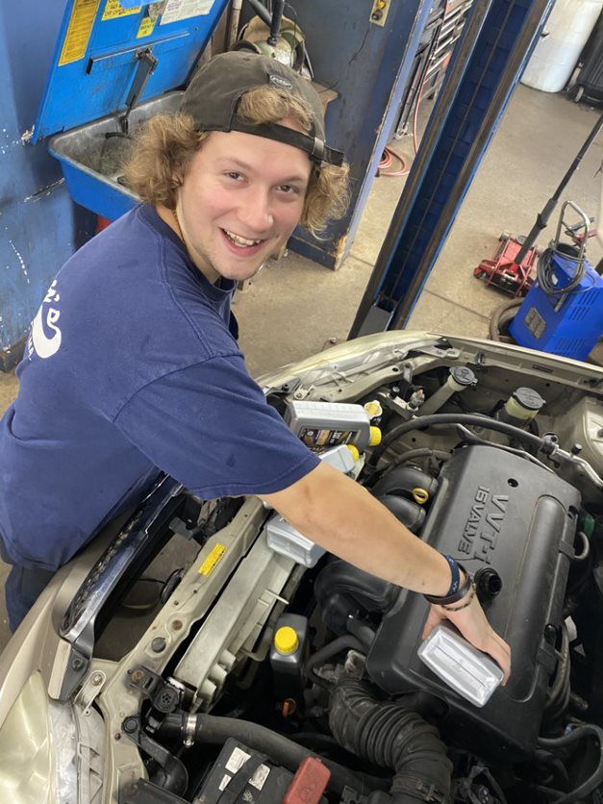
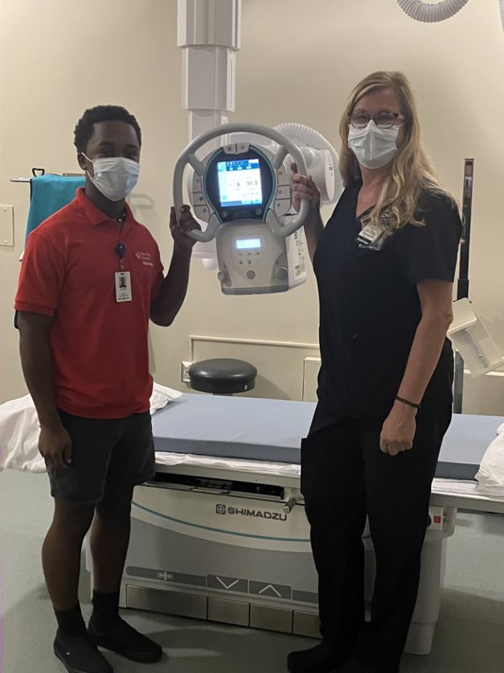
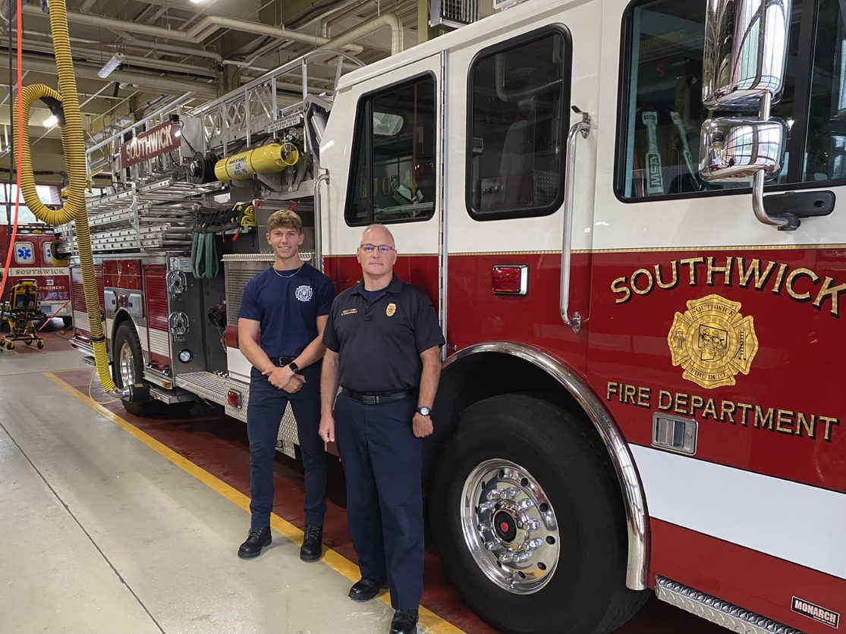
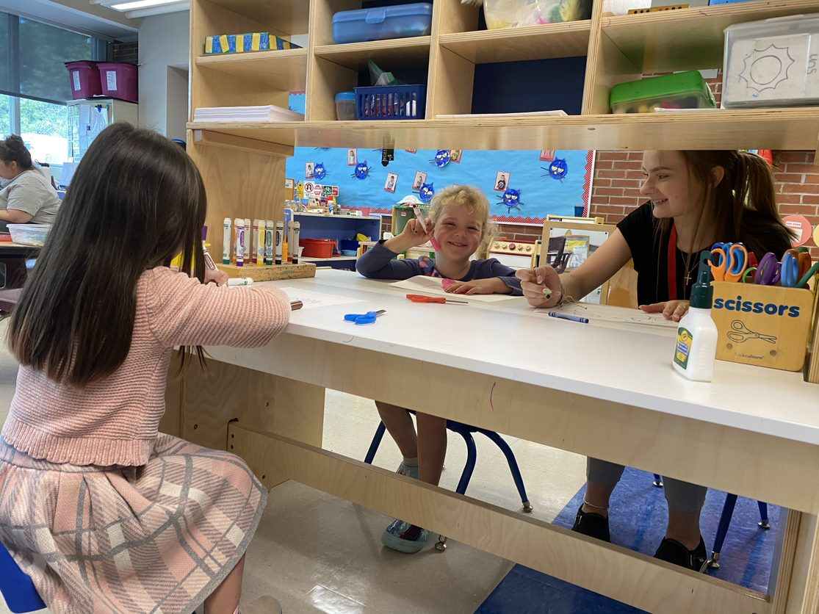
DLE INTERNSHIPS
AUTOMOTIVE
MEDICAL
EMERGENCY SERVICES
EDUCATION

Slide 9
College Admissions Panel
Holyoke Community College Representative
Angelique Rodriguez (arodriguez@hcc.edu)
Westfield State University Representative
Emily Gibbings (egibbings@westfield.ma.edu)
Western New England University Representative
Christopher Wystepek (christopher.wystepek@wne.edu)

Slide 10
THANK YOU…
Additional information
NCAA eligibility for athletes
Richard Atkinson Scholarship
Financial Aid Information –
www.fafsa.com
www.mefa.org

